Slide 1
Forecasting Bottle Sales
Notes:
Intro

Slide 2
Data Introduction & Aggregation
Year | Month | County | AlcFamily | Bottles Sold | Vol (Liters) | Sales ($)
2012 | 1 | Adair | Brandies | 197 | 124.49 | 1374.1
2012 | 2 | Adair | Brandies | 199 | 143.62 | 221.92
2012 | 3 | Adair | Brandies | 108 | 76.49 | 818.25
2012 | 4 | Adair | Brandies | 206 | 138.98 | 1559.83
2012 | 5 | Adair | Brandies | 114 | 79.95 | 1173.99
Data Aggregation
Grouped By
Year
Month
County
AlcFamily
Summary Statistics
Bottles Sold (Sum)
Vol Liters (Sum)
Sales ($) (Sum)
Notes:
Data Aggregation:
Data is aggregated by Year, Month, And Alcohol Family. Alcohol Family is a categorical variable that groups together smaller subgenres of overarching alcohol families to create more density within the dataset.
Table is example of what an aggregated data row looks like (obviously not all variables included just an illustration so they can understand what our data looks like)
Reasoning:
We chose to aggregate by these variables as most readily available external data would be available in this format. And for a distributor it makes sense for forecast over more dense windows as it can help with predictive power by eliminating some variability within transaction/transaction data.

Slide 3
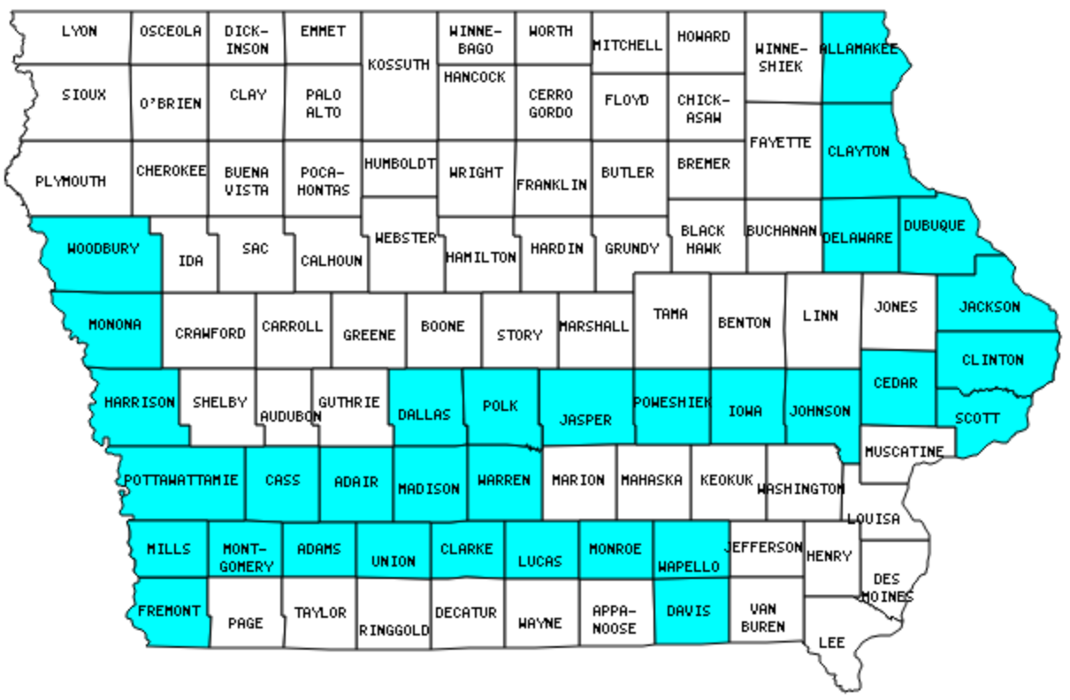

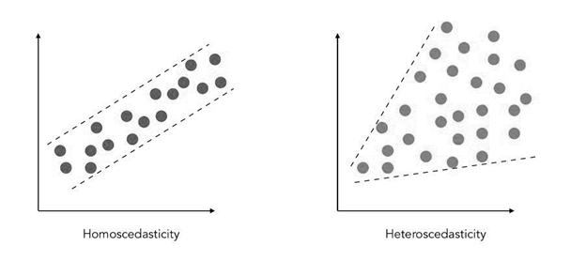

Model Development & Selection
Feature Abstraction
Feature Engineering
Notes:
MAIN GOAL: Create a model that predicts the amount of bottles that will be sold for a particular month within a particular county for a particular type of alcohol
We thought this response variable and aggregation would be useful as a distributor could roughly estimate their market share for a particular county and thus take a percentage of the total estimated bottles that will be sold that month and adjust their production, manufacturing, and marketing as necessary.
Feature Abstraction:
Another key feature of our model’s success is its ability to predict on data “outside of Iowa.” In order to accomplish this we performed EDA to investigate trends as to why certain counties sell much more alcohol than others. Rather than include the specific Iowa county, we scraped demographic and sales data regarding each county to generalize the performance so any county can be predicted on rather than just counties in Iowa. Secondly, we wanted to also abstract time trends rather than include year and month into our model to better model why certain trends happen as well.
Feature Engineering:
Heteroskedasticity: We noticed that our original non-transformed OLS model was performing very poorly on large sales due to higher variance. To combat this we transformed the response variable to the SQRT (Please note that the MSE and calculations on the following pages have been back transformed).
Previous Sales Data: Furthermore, because we are purely focused on the predictive power of the model, we featured engineered some additional variables such as rolling 3 month averages of the bottles sold, total amount sold in dollars, and previous years bottle sold to provide previous aggregate sales data.

Slide 4
Model Selection & Evaluation Results
Model Summary
OLS
MSE Loss Function
CV 5 Folds
Sqrt Transformed RV
Fold | OLS MSE | Baseline MSE | Improvement
1 | 104,256.3850 | 12,857,183.42 | 99.19%
2 | 104,709.0997 | 95,98,664.67 | 98.81%
3 | 101,764.1703 | 97,02,996.80 | 98.95%
4 | 985,69.2898 | 11,769,035.10 | 99.16%
5 | 1004,81.36 | 13,661,641.61 | 99.26%
Notes:
We Chose Simple ordinary least squares, Chose MSE as our loss function to maximize (Penalizes worse guesses harsher than MAE), both mae and mse being methods to how far off our predictions are from the actual values.
Compared a variety of models with different features and transformations and chose the model with the lowest MSE across 5 folds of Cross validation
Model chosen has SQRT’d RV as to minimize inconsistent spread
(Model’s variables shown on the next slide)

Slide 5
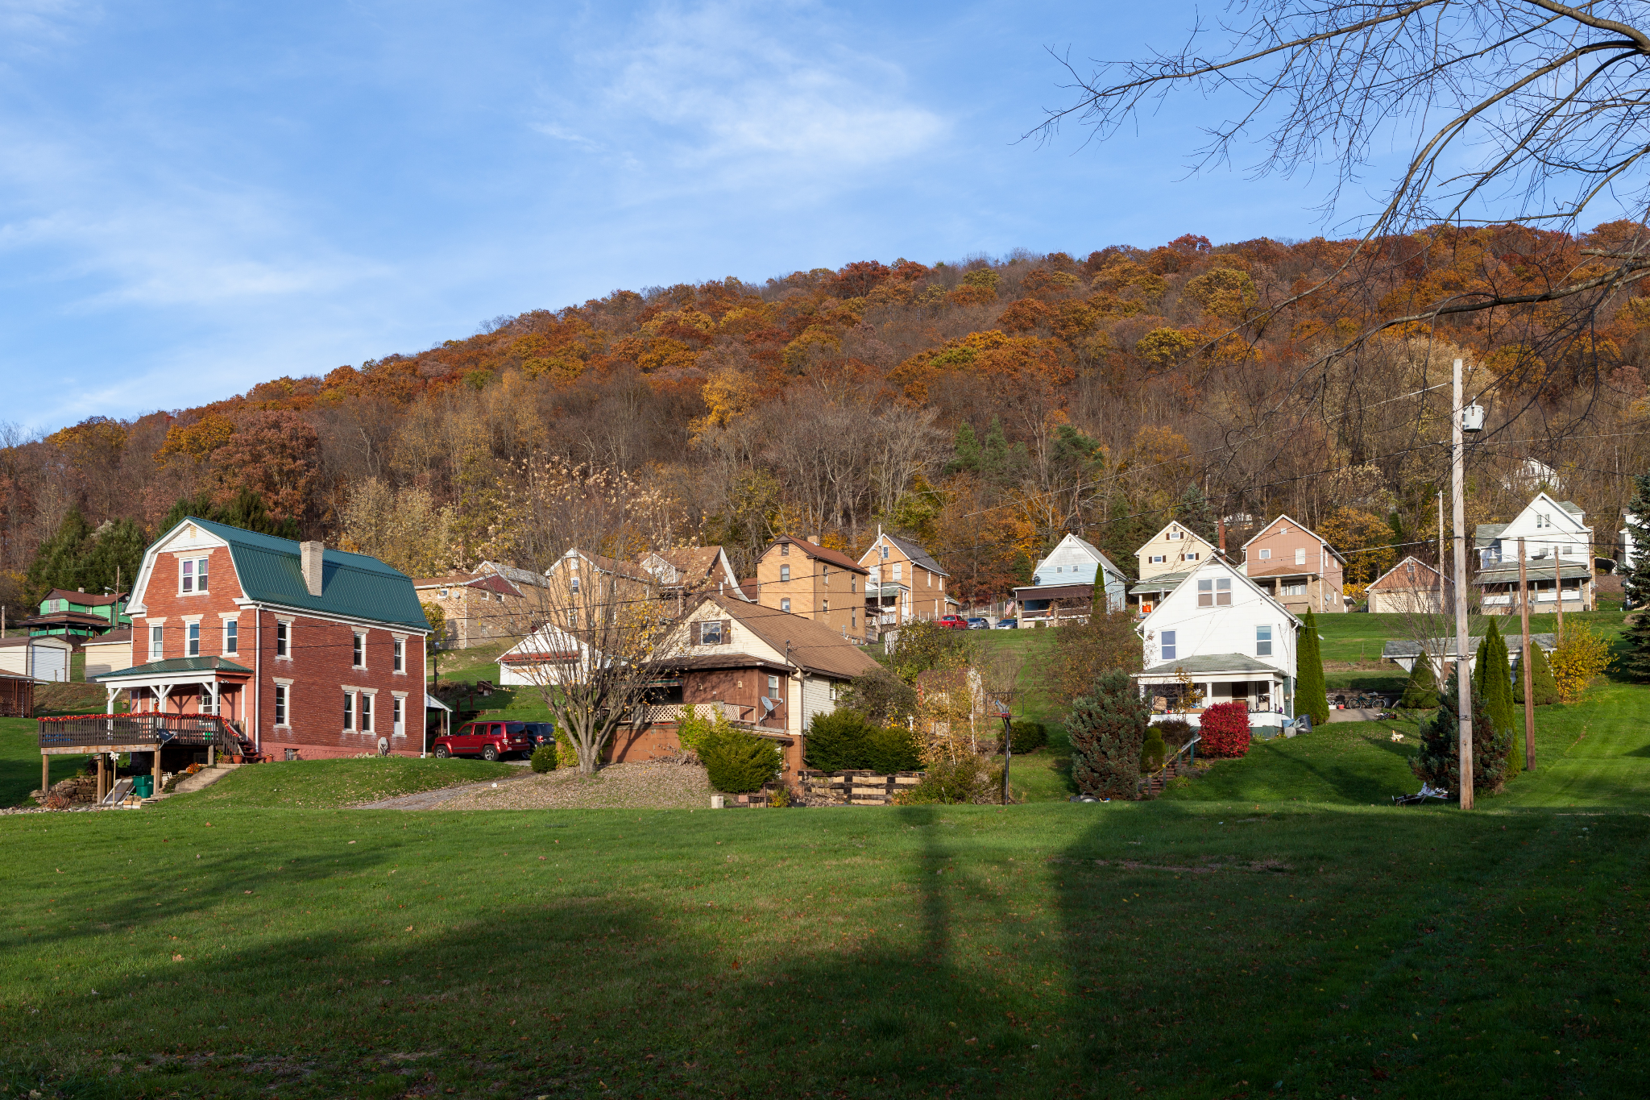

Example Model Usage
Previous Year Monthly Sales (Bottles): 54,399
3-Month Rolling Average Sales: 51,234
Log of Previous Year Sales: ln(54,399)
Log of 3-Month Rolling Average: ln(51,234)
Squared Sales (Previous Year): (54,399)^2
Squared 3-Month Rolling Average: (51,234)^2
Cubic Sales (Previous Year): (356,333)^3
1-Month Lag Sales: 50,123
3-Month Lag Sales: 52,238
Rolling 3-Month Sales: 162,456
Personal Income: $45,000
Alcohol Family Categories: Wine
Season: Winter
Final Model Prediction: 64,734 Total Bottles Sold
Notes:
Example Model Usage:
Armstrong County Penn
If distributor was interested in seeing what total Wine bottle sales will look like for the next month for this county they could implement the following information and get a nice prediction/forecast.
From this forecast they could either compare this number to other counties to decide which counties they want to prioritize, or utilize this number to make a marketing plan for certain counties. If you could estimate your market share for a particular county, it would give you a great idea of how many bottles you would need to manufacture, and thus you can do calculations on profit etc.

